Slide 1
Analysis of Group A Data
Andrew Meng, Kathi Munoz, Joseph Zou

Slide 2
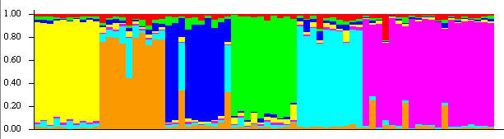
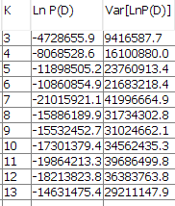
Structure - All data
Pictured above is the output for K=7. As the input to Structure was in the same order as the original output from SLiM, it is fairly easy to see differentiation between populations. Notably, Structure finds it easier to differentiate five populations (all except humans/spartans) into six than to split apart humans and spartans.

Slide 3
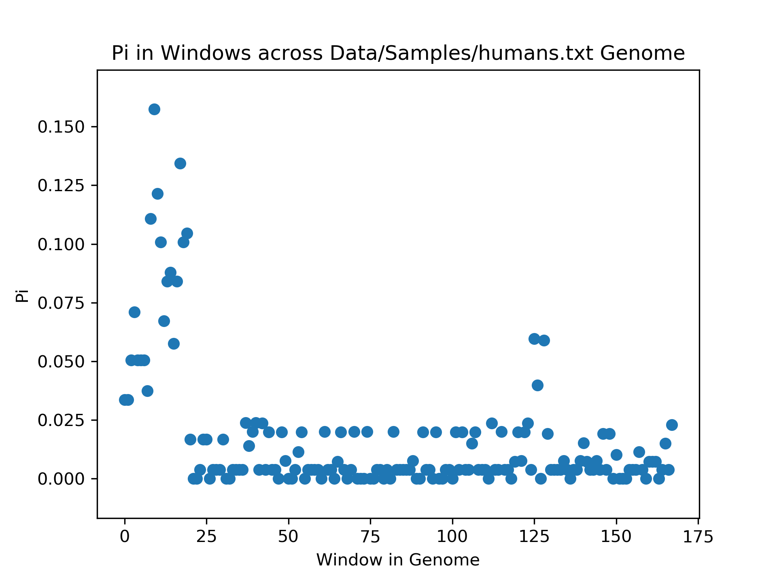
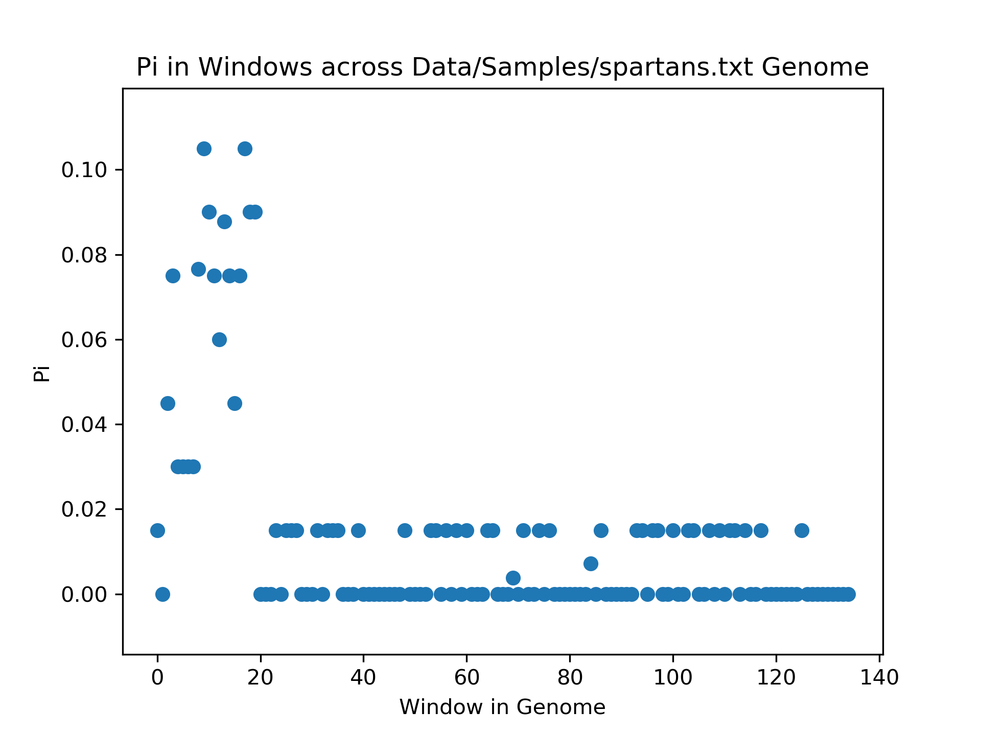
Similarities in Spartans and Humans - Polymorphism
Notes:
No other graph had a shape similar to either of these, and these two look too abnormal to be coincidentally similar, further supporting the claim that there is some relationship between humans and spartans. Additionally, there is more noise, in appearance, in the humans’ graph, but the stratified pattern of relatively low polymorphism exhibited by the spartans’ graph was observed in graphs of polymorphism of other populations as well; this fact suggests that levels of diversity within a population are fairly consistent across the genome. However, the higher peak polymorphism of the sample of humans may be noteworthy, as there are several sites with a higher degree of polymorphism than any that was measured within the sample of spartans.

Slide 4
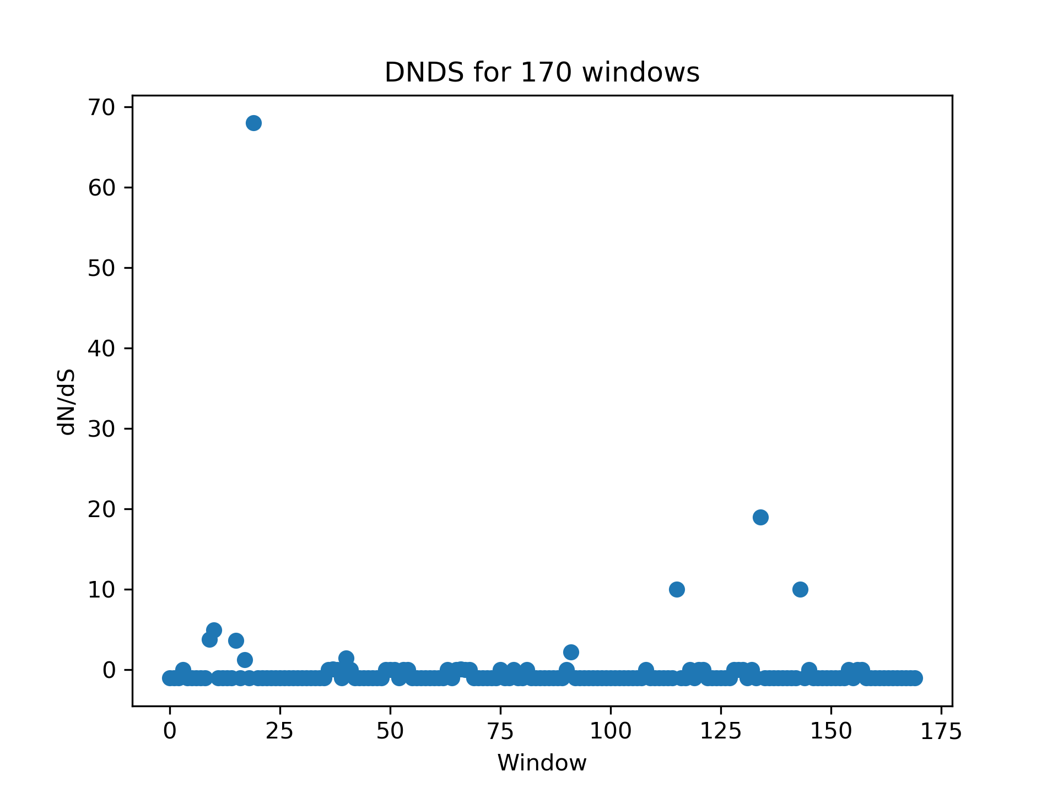
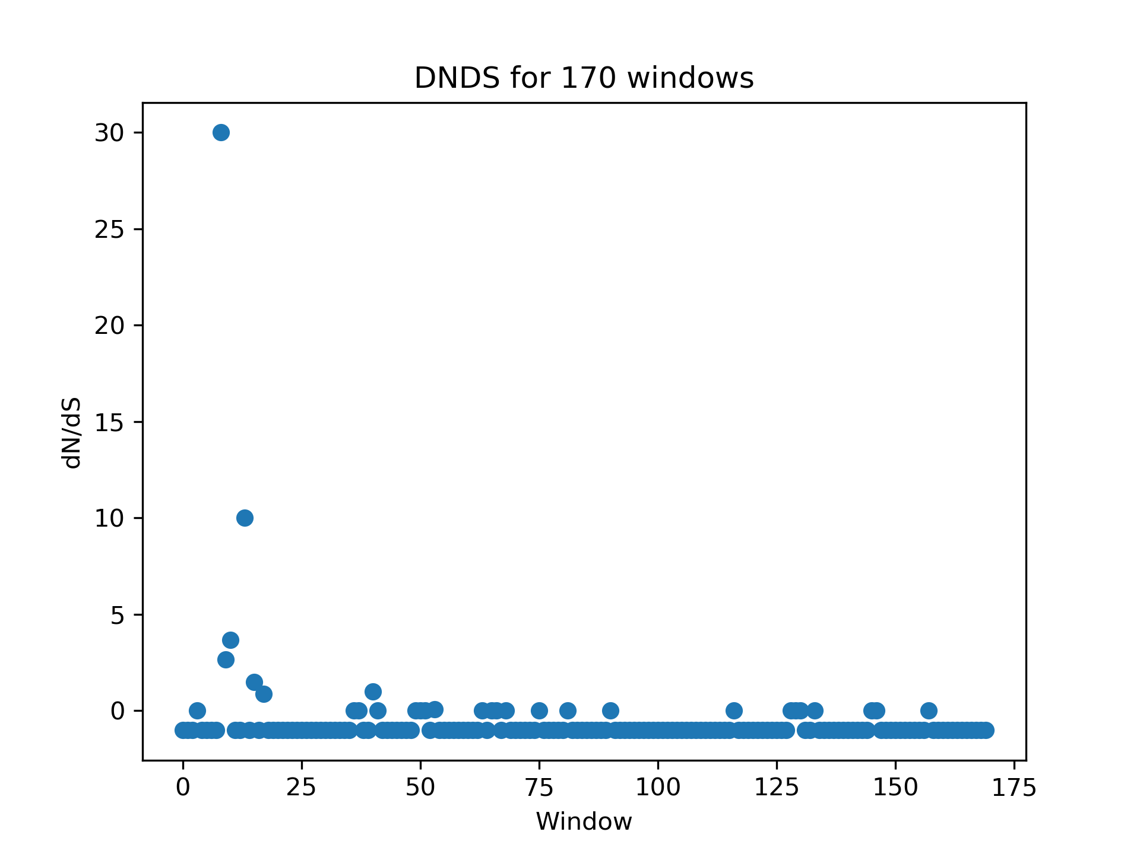
Similarities in Spartans and Humans - dN/dS
Humans
Spartans
Notes:
As usual, humans’ and spartans’ metrics share many similarities. In about the same location as the peak in polymorphism observed earlier, a peak in dN/dS in both spartans and humans is observed here. The surface conclusion of this fact is that each is experiencing strongly positive selection around this location. The rest of the graphs include a lot of negative ones (which was our solution in the case that dS was zero). This pattern indicates a relatively small amount of synonymous mutations found in each sample of humans and spartans and means that, in both humans and spartans, a mutation is relatively likely to affect the individual’s fitness in some way. We observed this abundance in multiple populations; this feature was not unique to spartans and humans.

Slide 5
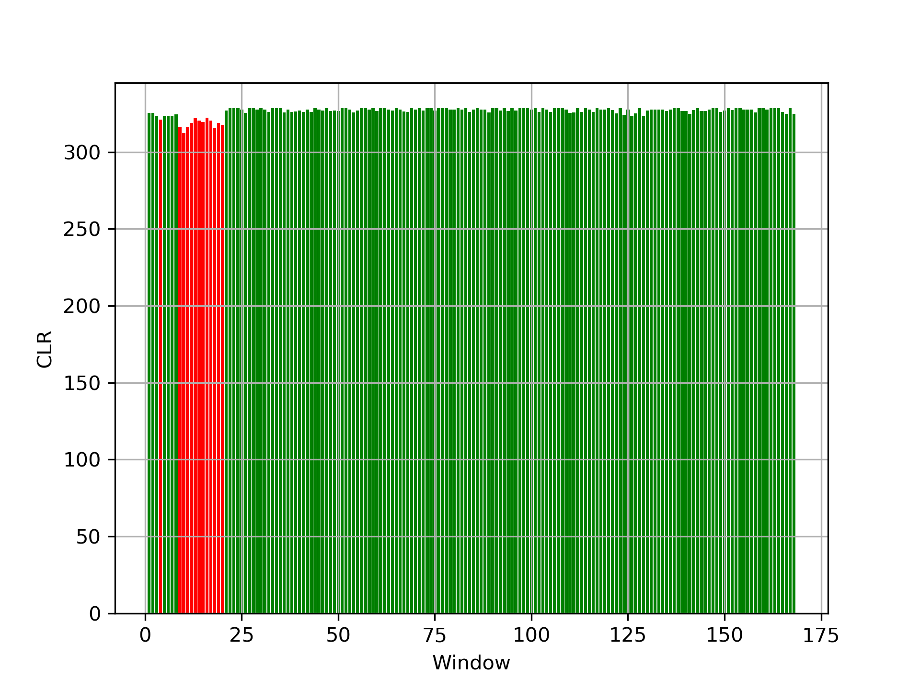
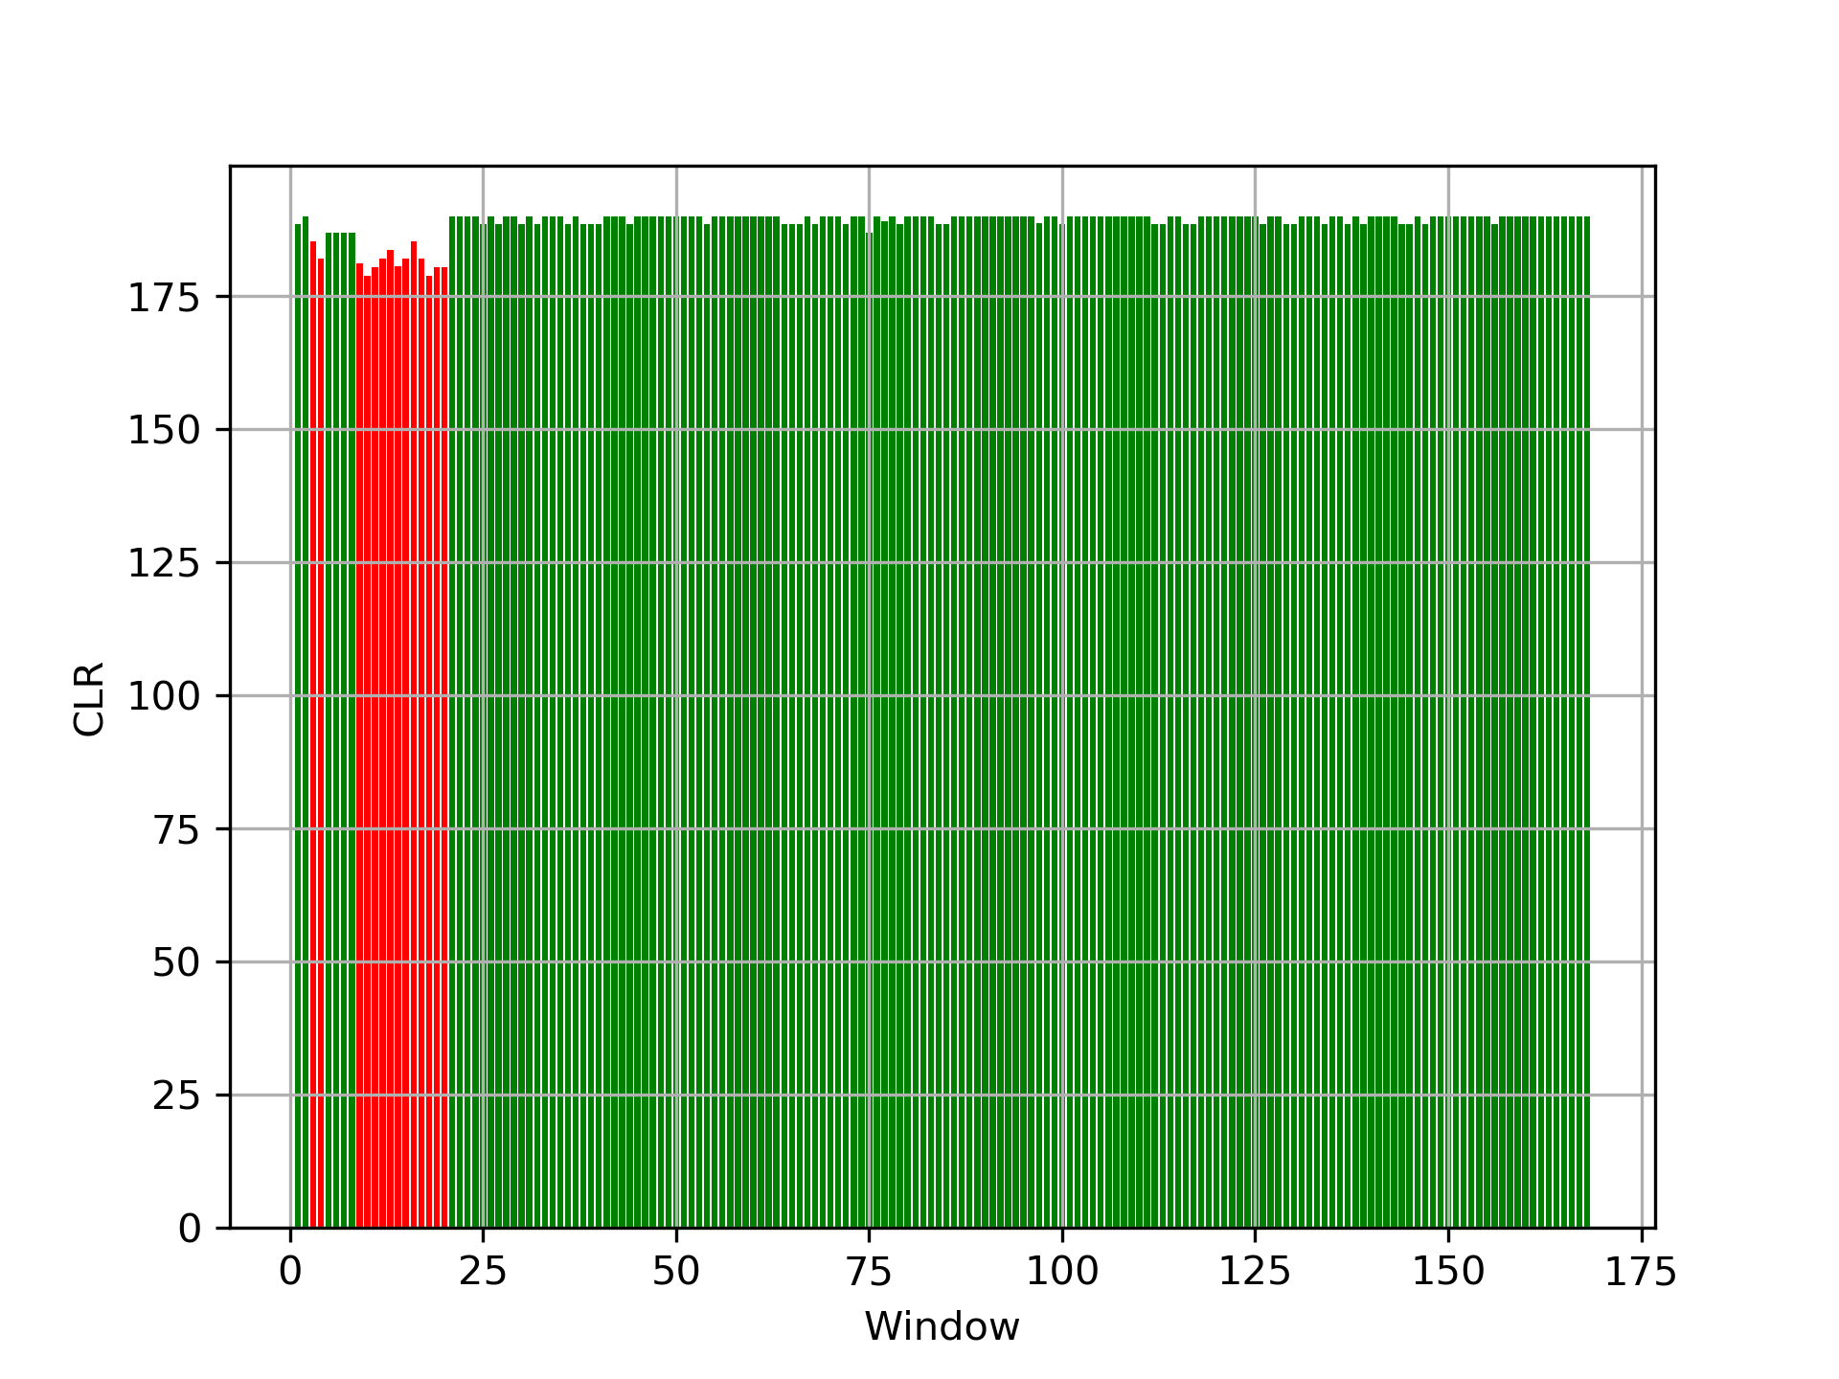
Similarities in Spartans and Humans - Sweeps
Humans
Spartans
Notes:
As might be expected, the graphs look similar. However, in computing the age of the expected sweep in each population, the calculated age of the spartans’ sweep was greater than that of the humans. We found the age of the sweep in the human population to be about 1000 generations and the age of the sweep in spartans to be about 7000 generations. This conflicts with our knowledge of humans and spartans, according to which spartans evolved from humans. We interpreted this to imply that the age of a sweep in the spartan population should be younger than one in a human population.
We also found there to be a very high amount of polymorphism in the locations corresponding to the predicted sweep, which conflicts with our understanding of sweeps. However, we have found instances of this phenomenon in several cases in our own data. This may be a result of complications such as migration or abrupt changes in population size.

Slide 6
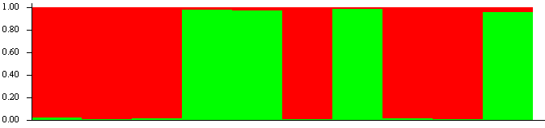

Structure - Humans and Spartans individually
Each of humans and spartans can be separated fairly succinctly by structure into two categories, whereas other populations did not exhibit this characteristic.
Humans, K=2
Spartans, K=2

Slide 7
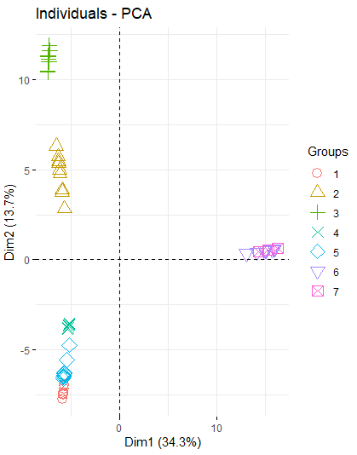
PCA - All data
Groups:
1 - Prophets
2 - Elites
3 - Brutes
4 - Jackals
5 - Grunts
6 - Humans
7 - Spartans
The only two populations overlapping in the output of this PCA are humans and spartans, but jackals, grunts, and prophets also are lumped very closely together.
Notes:
The big take away here is that all the populations are pretty clearly defined, with the exception of humans and Spartans - PCA has them very much overlapping and this would help explain some of what we see in the Structure plots for these two populations. The relationship between these two is known to us just from our common knowledge of the game, but its strength was made very clear in our analysis and was a theme of interest to us. Jackals, grunts, and prophets may be lumped for some significant reason, but it could also be the result of imperfect, two-dimensional representation.
Based on Structure’s inability to differentiate between humans and spartans when K is assumed to be 7 combined with PCA’s claim that spartans and humans overlap in these two composite dimensions, we believe that there is migration between humans and spartans. Unfortunately, we do not have any data describing a composite population of humans and spartans only, so any computations we have done regarding migration rate is inherently flawed (we use a composite sample of all seven populations instead).; in addition, we necessarily violate the assumption that each population is significantly smaller than the ‘mainland’ because at least one of the two populations must be greater than or equal to half the size of the total. Additionally, we have mounds of evidence suggesting selection is most certainly at play, another violation of the assumptions for this computation. Using this flawed computation, we have found that the migration rate from humans to spartans is m=0.00038 using s, or m=8.1*10⁻⁶. We assume that humans are migrating to spartans because, using both pi and s, N_{e} is smaller in spartans.

Slide 8
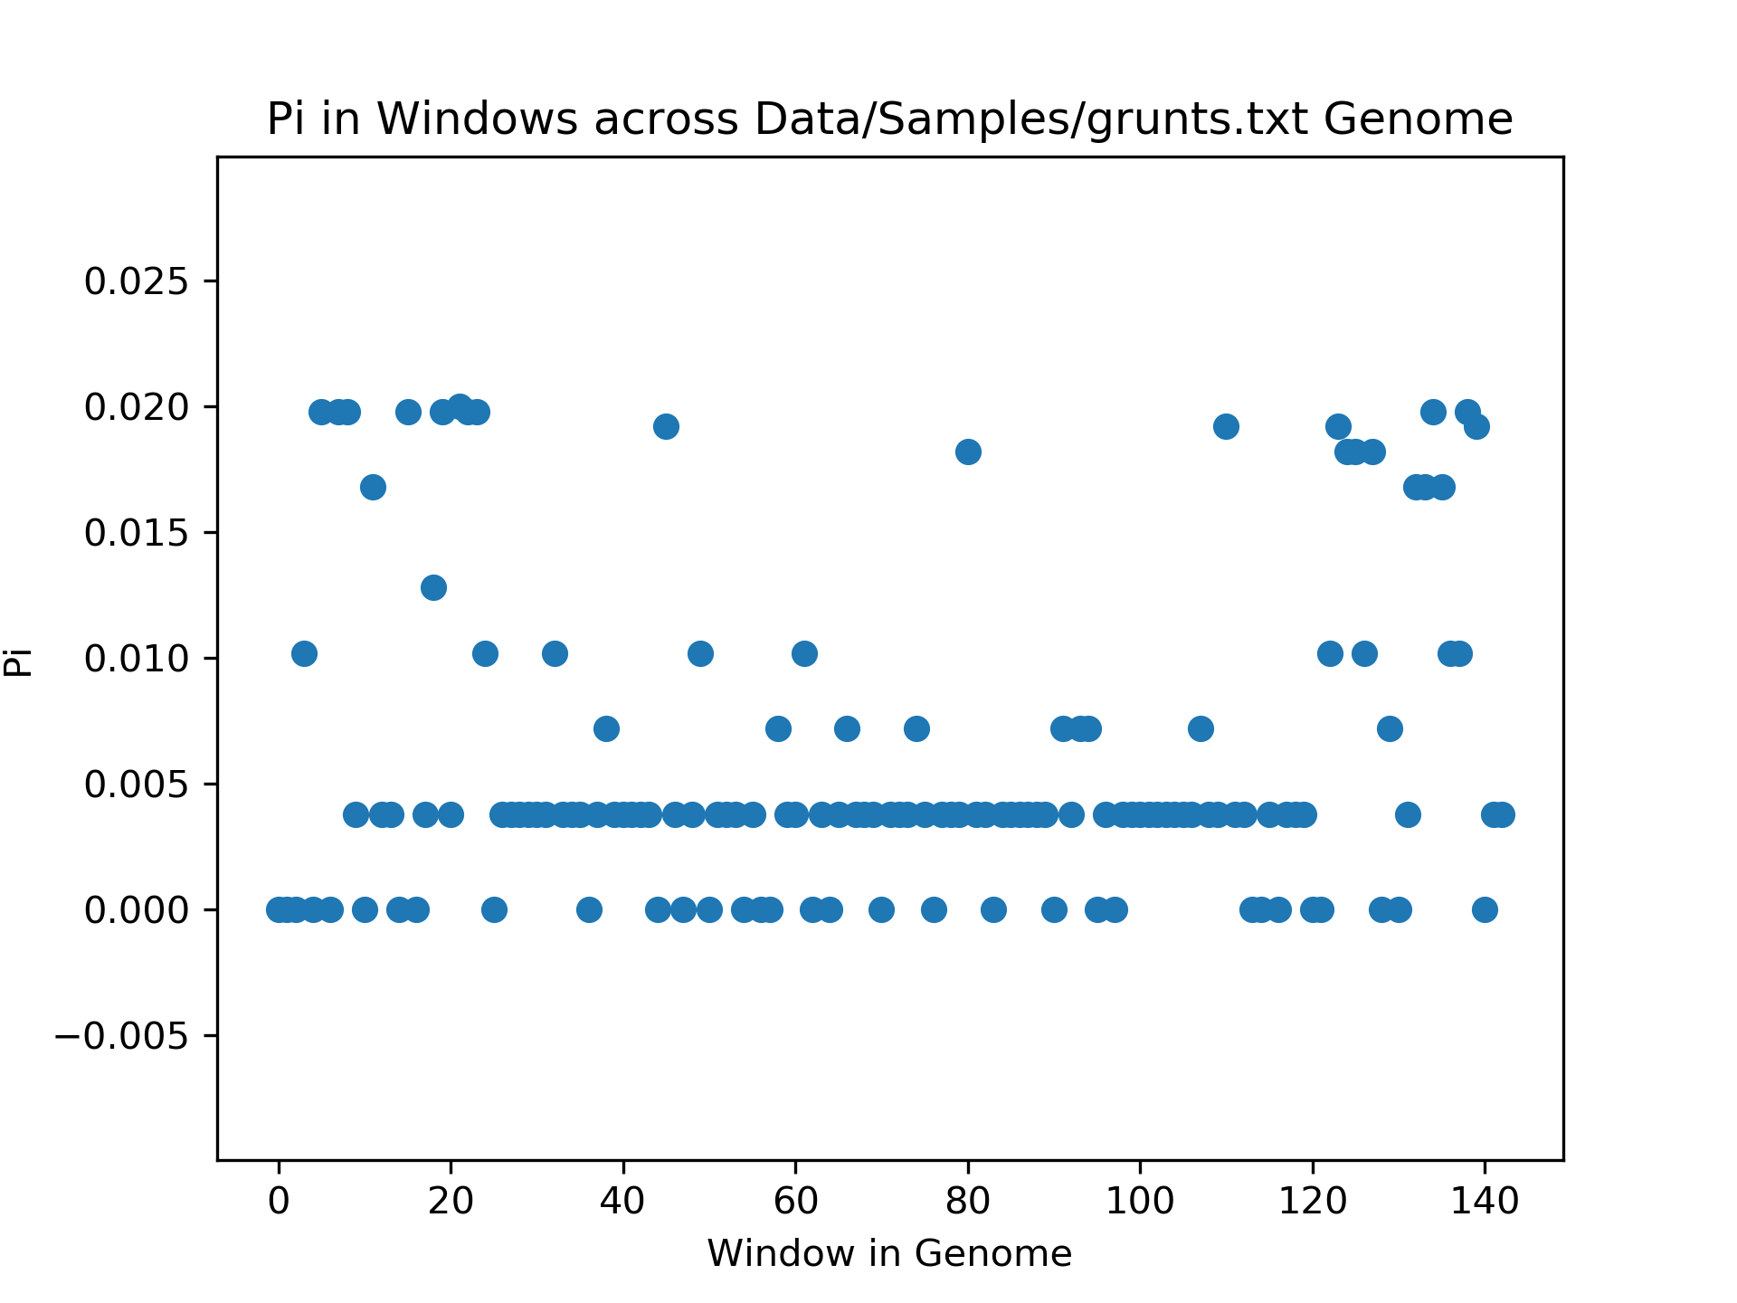
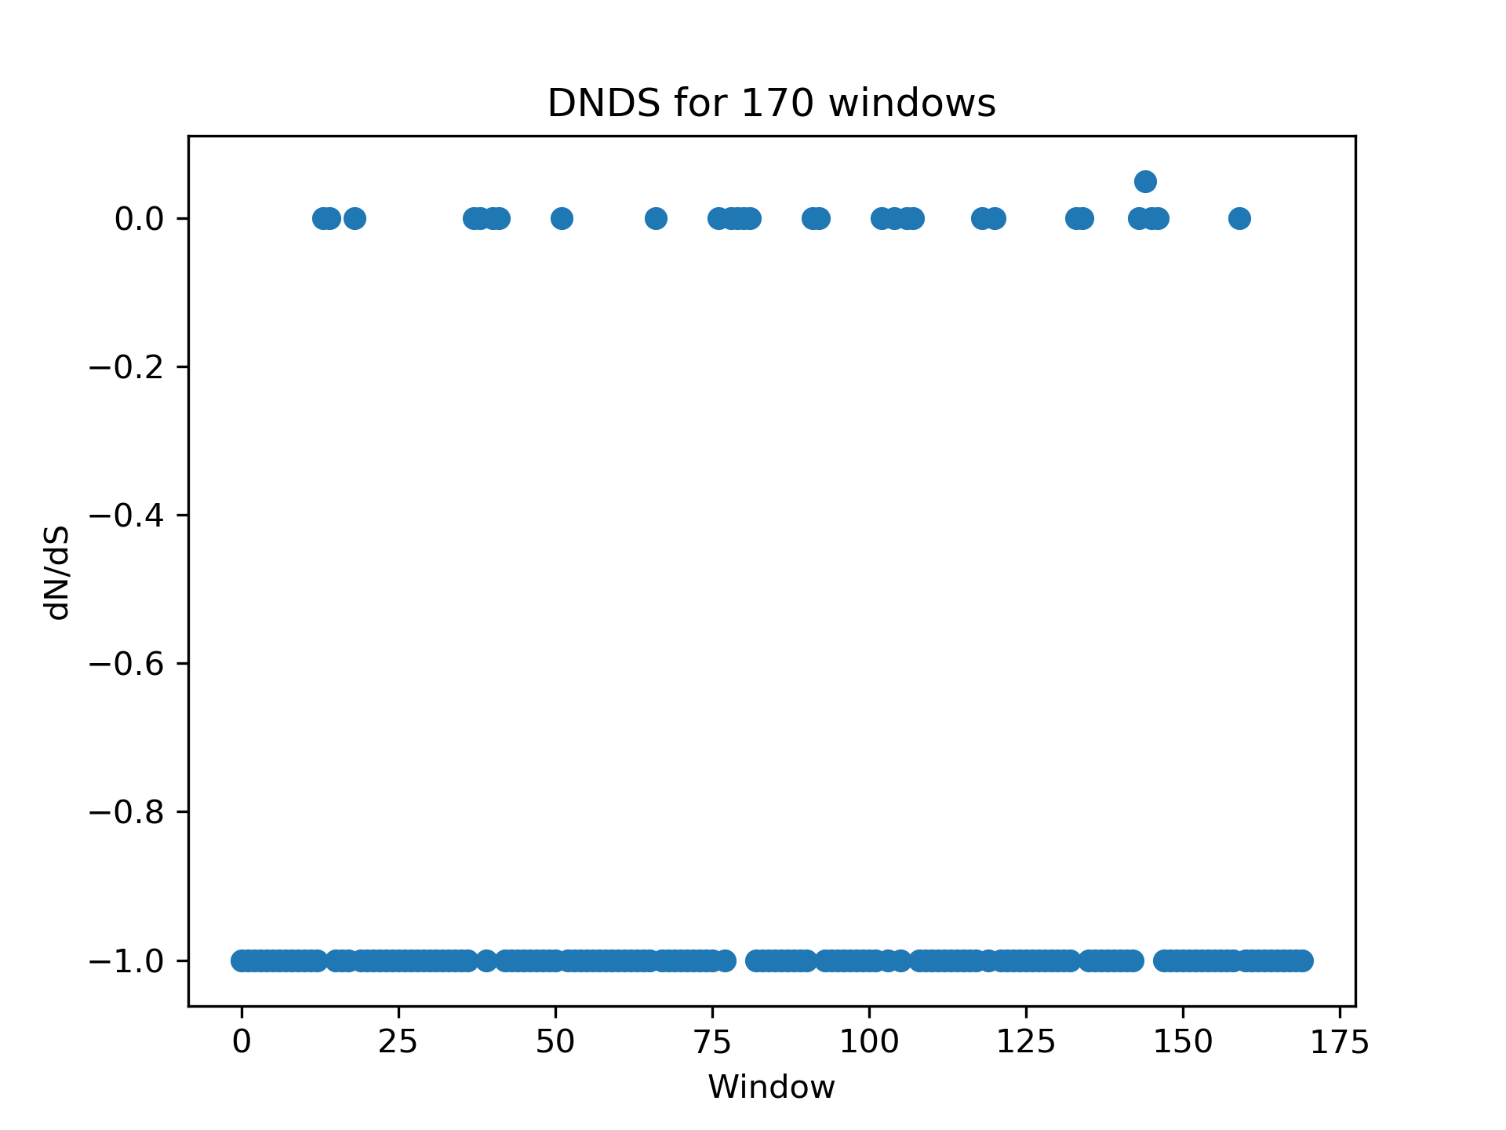
Grunt Population Dynamics
Notes:
Another trend we noticed in our analysis was the very low diversity seen in the Grunts population compared to the rest. Looking at the graph of Pi values, the range of values as well as the magnitude is very small (mostly zero) compared to the rest of the populations. Additionally, the dN/dS ratios mostly have one of two values: -1 or 0, again indicating very low diversity. Having a majority of dN/dS ratio of -1 and 0’s tells us there just aren’t a lot of mutations in this population.This suggests to us that the Grunt population experienced either a bottleneck or population-reducing event of some kind. We find further support for this, at least a small population size, as in our calculations of N_{e} we find them to be the smallest (using Pi) or second smallest (using S).

